Slide 1
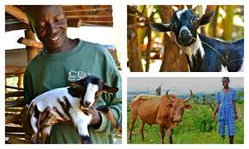
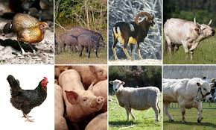

Generating Employment Opportunities Through Agriculture
Prince Gbolahan Lawal

Slide 2
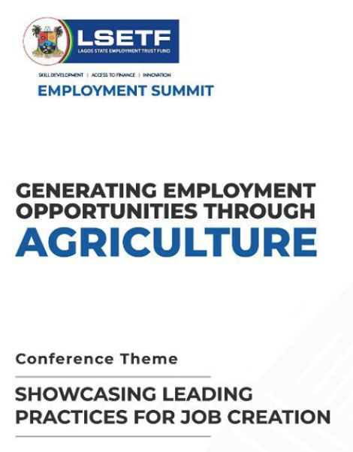

Slide 3
INTRODUCTION
Nigeria’s population will grow swiftly and transform extensively in the next three decades.
Between 2015 and 2050 the population will double to almost 400 million and the number people living in urban areas will triple from the current 94 million to 280 million.
GDP per capita will almost triple up to around 7137 USD PPP.
The UN claims that Food Production must double by 2050 to meet the demand of the world’s growing population.

Slide 4
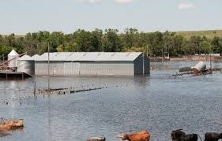
INTRODUCTION CONT’D The Woes of Oil
Our over - concentration of economy on oil and oil-allied products has caused Nigeria to remain poverty trapped. Currently shamefully tagged the poverty capital of the world.
In order for us to break this jinx, we must look elsewhere.
Agriculture (whether Livestock, Aquaculture or Crops) remains a veritable way of escape for us, unfortunately this is being currently sufficiently untapped.

Slide 5
INTRODUCTION CONT’D
For the purpose of sustainability, the role of agriculture cannot be over - emphasized.
Hence, the sensitization of farmers and youths to take Agriculture as a business in order to transform it from subsistence production to commercial and profitable business.
Several opportunities abound in agriculture because each of the agricultural enterprises has various value chains, which if properly explored, presents great opportunities that are income yielding and very viable.

Slide 6
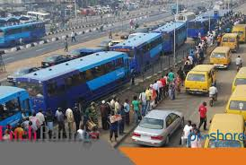
INTRODUCTION CONT’D
Uniqueness of Lagos State:-
Population
Land Space
Economic Activities
Demand for Food
Food Security
Good Governance
Rural Urban Migration

Slide 7
INTRODUCTION CONT’D
The UN claims that Food Production must double by 2050 to meet the demand of the world’s growing population.
However, most of the Agricultural farmland is already in use, so increased food production will require extending intensive farming methods .
The current statistic of local food production in Lagos State, with its population of over 22 million, is placed at 18% of the food demand. Over 80% of the food needs of Lagosians are provided from outside the State.
This gap presents a window of opportunities which if properly harnessed, could be a goldmine for the teeming youths and other players in the agricultural sphere.

Slide 8
Supply and Demand of Agricultural Produce in Lagos State
S/N | Item | Local Production (MT) | Demand (MT) | Shortfall/ Gap (MT)
1. | Rice | 63,900 | 4,200,000 | 4,136,100
2. | Cassava | 1,470,040 | 10,500,000 | 9,030,000
3. | Yam | 90 | 250,000 | 249,910
4. | Tomato | 29,980 | 700,000 | 670,020
5. | Cowpea | 1,480 | 315,000 | 313,520
6. | Maize | 188,340 | 660,000 | 471,660
7. | Coconut | 182,000 | 378,000 | 103,500
8. | Beef | 280,800 (Processed) | 343,200 | 51,168
9. | Mutton | 11,232
10. | Fish | 155,262 | 374,000 | 218,738
11. | Poultry (Egg) | 213.2 | 280 | 66.8
12. | Poultry (Broiler) | 72,000 | 260,000 | 188,000
13. | Pig | 6,190 | 123.4 | (6,066.6)

Slide 9
AGRICULTURAL PROFILE OF LAGOS STATE
GEOGRAPHICAL DATA
• Total Land Area of the State: 347,500 Hectares
• Swamp and Water bodies: 75,755 Hectares
• Cultivable Area in the State: 169,613 Hectares
• Area under Cultivation: 50,884 Hectares
• AGRICULTURAL DEMOGRAPHY
• 180km Atlantic Ocean coast line (Fishing, Coconut & Tourism)
• 6,500/Km2 Population density
• 45% rural dwellers
• Agriculture employs 70% of rural population
• Extension services supporting 350,000 farming families
• Urban agriculture predominant in fish farming, horticulture and
vegetable farming

Slide 10
COMPOSITION OF MAJOR FARMING ACTIVITIES IN LAGOS STATE
Agro – Processing/ Value Addition:
11%
Fish Farming:
31%
Livestock Farming:
24%
Crop Farming
34%

Slide 11
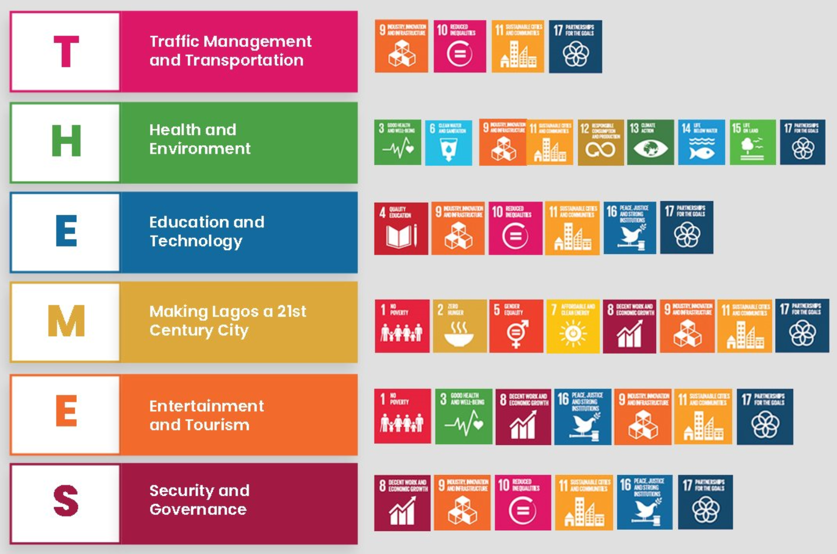

Lagos State has a Vison that is part of the Sustainable Development Goals

Slide 12










MoA Keys into the following Sustainable Development Goals

Slide 13
The THEMES Agenda of Lagos State’s present administration led to the Ministry of Agriculture’s vision of Making Lagos State a 21st Century Economy through Agriculture.
This vision is in turn behind the Ministry’s Five – Year Road Map to ensure agricultural productivity at the upstream, midstream and downstream sectors of seven value chains and services where the State has competitive and comparative advantage.

Slide 14
POTENTIALS
• Strategically, the efforts of the Ministry of Agriculture is geared towards areas of
livestock, fisheries, rice and vegetable production
where the State has comparative and competitive
advantage with diverse investment opportunities and
emphasis on value addition.
• These opportunities can be accessed by discerning
investors through keying into numerous Government
programmes that are deliberately created to
facilitate profitable agricultural investments.

Slide 15
Summary of Agricultural Opportunities and Potentials
Crops • Rice • Vegetable • Coconut • Value Addition | Livestock • Poultry • Ruminants • Abattoir Development
Fisheries • Fish farm Estates • Cage and Pen Culture • Artisanal Fisheries | Agro-Processing • Tubers processing • Other crops processing • Forestry by-products
Packaging and Marketing | Strategic Food Storage • Silo construction • Agro-Parks
Input Supply | Food Safety and Hygiene

Slide 16
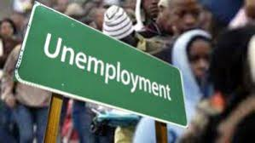
Direct relationship between poverty and unemployment
Unemployment and poverty are Siamese twins
Wherever unemployment abound, poverty becomes inevitable
There is a direct relationship and correlation between poverty and unemployment.
Unemployment and the poverty are two major challenges that are facing the world at present (and Lagos State is not immuned).
Unemployment leads to poverty and in turn, poverty leads to unemployment.

Slide 17
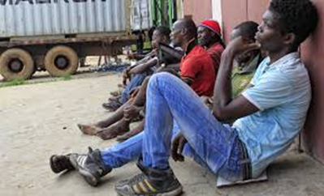
Poverty is a sign of unemployment, which in turn leads to financial crisis, hunger, gloom, indebtedness, crime, prostitution, etc.
An unemployed person has no means to earn money and cannot fulfil his own and his families basic needs. He and his family cannot avail quality education, medical facilities and have no means to create income earning assets.
Actions of policymakers should therefore be directed at creating vocational skill programmes to aid curbing of unemployment problem.

Slide 18

Ladder of Opportunities in the Poultry Value Chain
Breeders / Hatcheries
Rearing (DOC for Table Meat / POL for Layers)
Egg Marketing
Marketing of Old Layers
Broiler Processing
Transportation of Animals and Inputs
Feed Mill (work force – Commercial Millers & Toll Millers)
Raw Material Input Suppliers / Importers (Maize, Sorghum, Wheat, W/Offal, Cassava, Soya Beans, GNC, PKC, Salt, Fish Meal, Premixes, Amino Acids – Lysine, Methionine)
Direct / Contract Crop Producers / Growers (e.g. Grains)
Engineers / Technicians (manufacturing, repair of machineries, fabrication)
Animal Health Manager (Veterinary Doctors, Animal Scientists, Extension Workers)
Nutritionists – for feed formulation
Pest Controllers
Waste to Wealth/ Manure Management (conversion to gas)

Slide 19
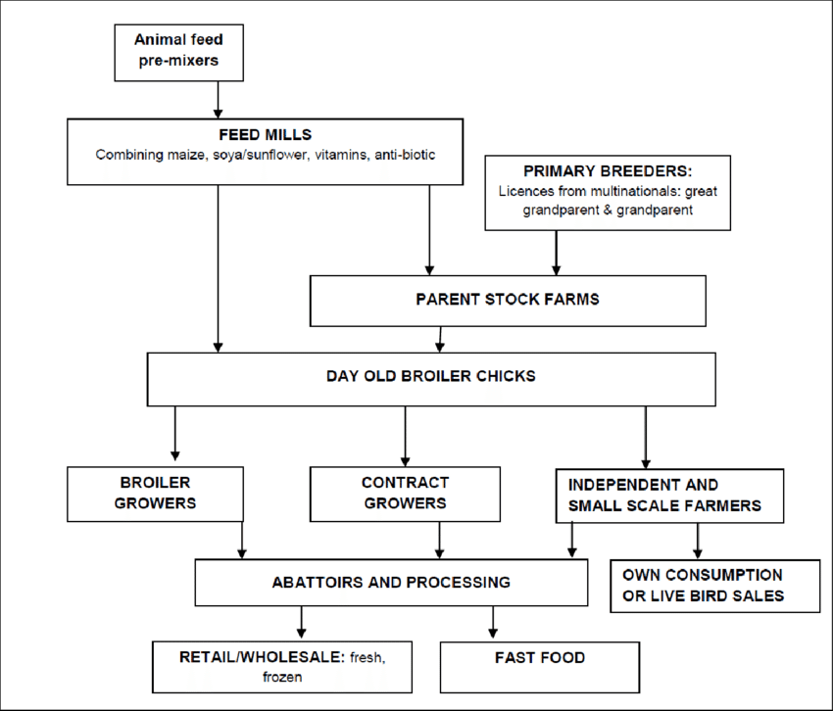

Slide 20
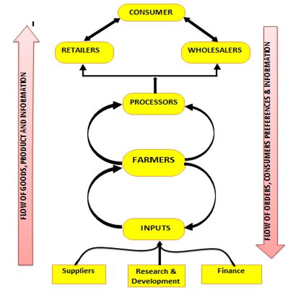

Slide 21
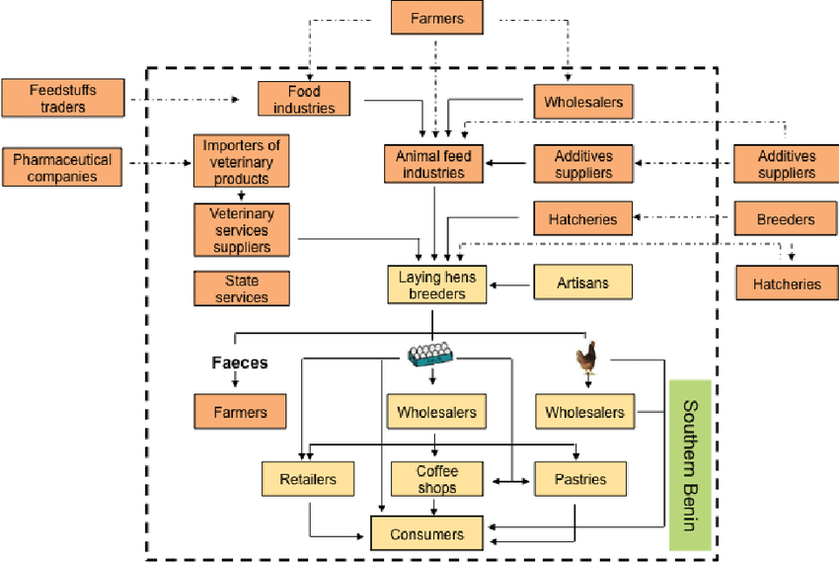

Slide 22
Opportunities in the Poultry Value Chain:-
Prospective Investors can apply for land from the Agricultural Land Holdings Authority (ALHA) to establish small, medium and large scale poultry business.
Farmers in the poultry business can raise Day Old Chicks (DOCs), process their poultry feeds and meat at the Lagos State Ministry of Agriculture’s Poultry Feed Milling and Processing Centre at Erikorodo in Ikorodu which has a:
* 15,000 capacity brooding house
* 2.5 tonne per hour feedmill capacity
* 250 birds per hour processing facility
There are opportunities in Egg Powder production given the over 60 million fresh eggs that are produced annually in the State.

Slide 23

Opportunities in Abattoirs & Cattle Lairages
Meat Inspectors
Blood Meal Processing
Hides and Skin
Hooves and Horns
Private Security Organisations
Sanitation Workers
Fresh Meat Sellers
Meat Processing/ Frozen Food Sellers
Operators
Labour
Management
Distribution
Veterinary Doctors

Slide 24
Lagos Abattoir
 | Direct Jobs | Indirect Jobs | Induced jobs | Total
Abattoir | 100 | 255 | 126 | 481
The recent 3-pronged approach in the Red Meat Value Chain tagged “ATM” is another avenue for employment generation in this livestock sector.
The acronym means Abattoir, Transportation and Market.
There is an ample opportunity in the abattoir section whereby unemployed youths can be gainfully engaged.
Transportation of the red meat and the personnel can equally be harnessed, while the marketing of the various products of the abattoir is also open to interested people especially the youths.

Slide 25
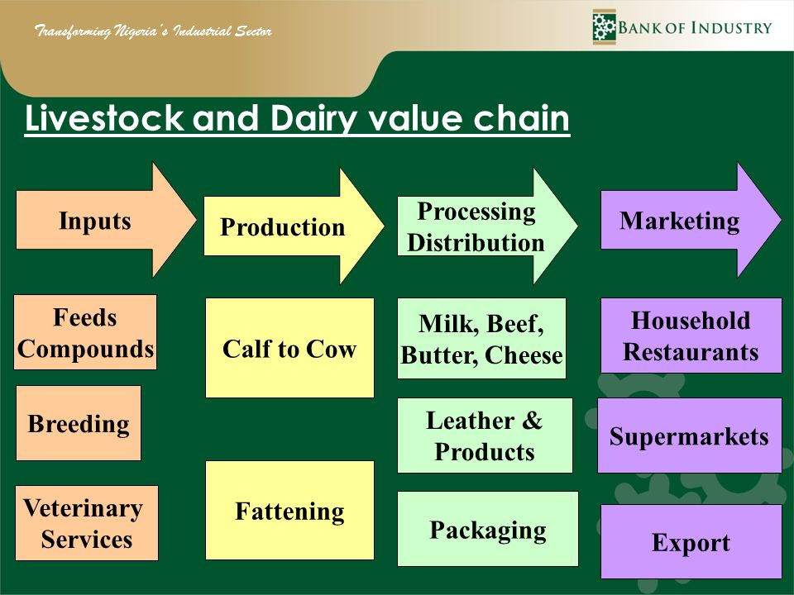

Slide 26
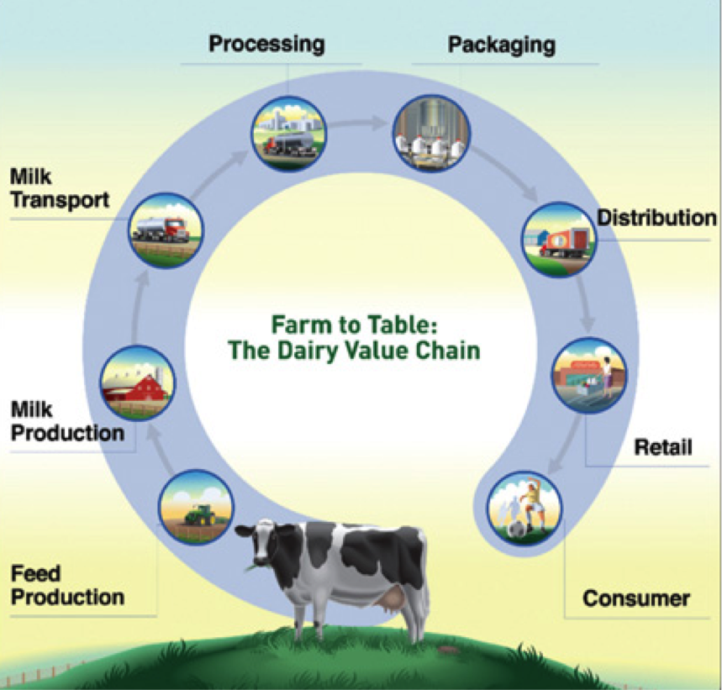

Slide 27
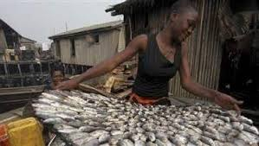
Opportunities in the Fish Value Chain
The Nigeria Fisheries sub - sector contributes about 3 - 4 percent to the country’s annual GDP and is an important contributor to the population’s nutritional requirements, constituting about 50 percent of animal protein intake.
In addition, the sub-sector generates employment and income for a significant number of artisanal fishermen and small traders.

Slide 28
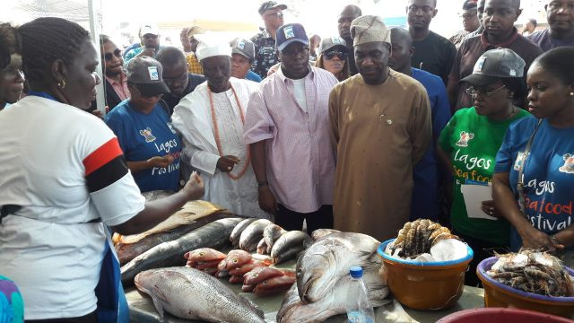
Opportunities in the Fish Value Chain CONT’D
To reduce the level of fish imports and in consonance with the findings of FOA, aquaculture has been selected as one of the priority value chains targeted for development and employment by the Lagos State Government in her 5 - Year Road Map.

Slide 29
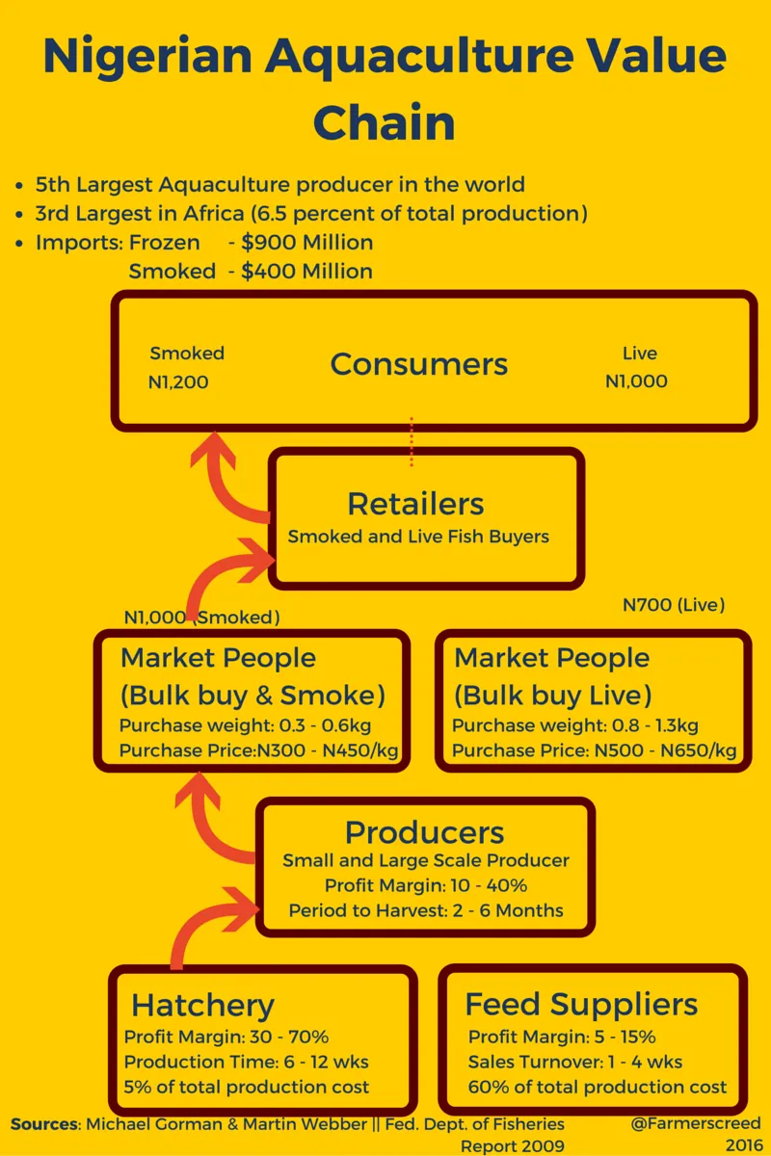
Opportunities in the Fish Value Chain CONT’D

Slide 30
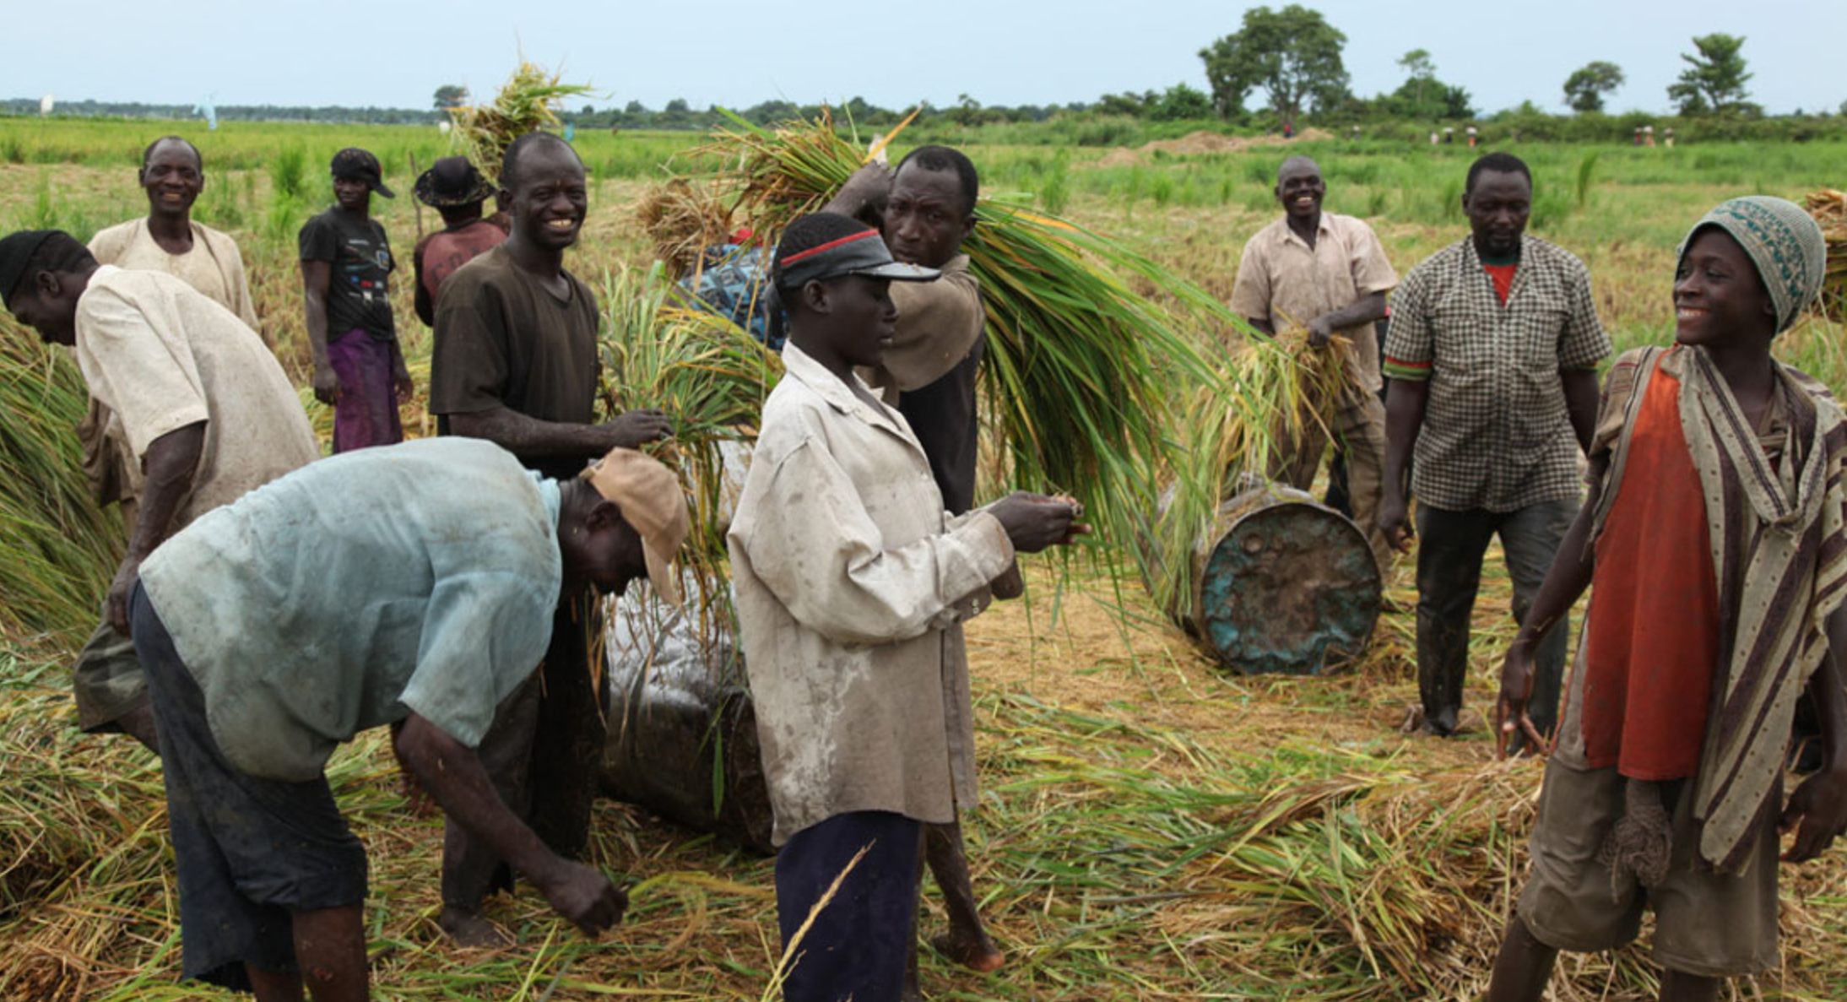
Opportunities in the Rice Value Chain
RICE PADDY PRODUCTION:-
On an annual basis, 200,000 tonnes of paddy would be required to feed the new 32MTPH Lagos State Rice Mill to be established at Imota, Ikorodu LGA by the 3rd quarter of Y2020.
This translates to more than 30,000 hectares of farm land over two crop cycles, of 3 tonnes per hectare
Roughly 20,000 small and medium farmers would be required to fulfil the demand
It is expected that over 267,580 new jobs will be created in the Rice Value Chain through the sales and distribution of LAKE Rice, the multiplication of improved planting materials, as well as, the establishment of the new 32MTPH Rice Mill.

Slide 31
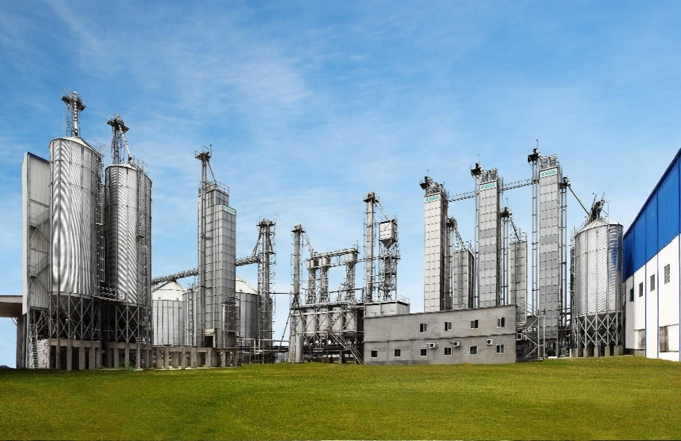
Rice Mill Operations
Direct Jobs
The rice mill direct employment of
Operators
Labour
Management
Distribution
Rice Paddy Production Jobs Impact
 | Direct Jobs | Indirect Jobs | Induced jobs | Total
Farmers (Paddy) | 20 000 | 14 880 | 10 440 | 45 320

Slide 32
Rice Mill Operations
 | Direct Jobs | Indirect Jobs | Induced jobs | Total
Rice Mill Staff | 500 | 5 320 | 2 140 | 7 960

Slide 33
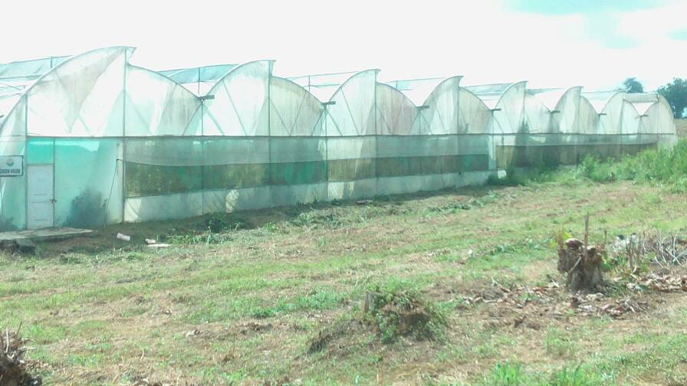
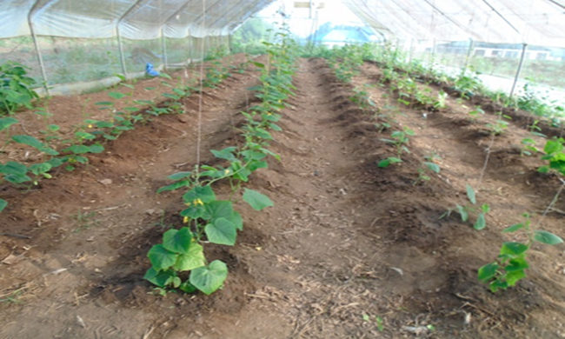
Cultivation of Crops in Greenhouses

Slide 34
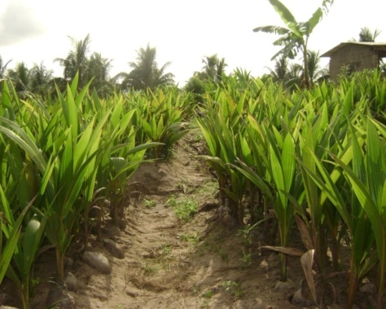
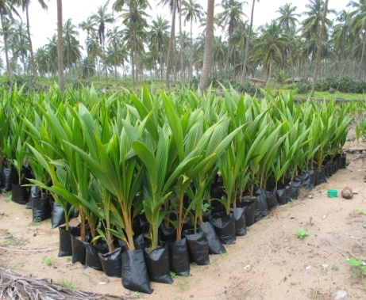
Multiplication of Improved planting materials

Slide 35
Opportunities in Coconut Development:-
The State has 180 Km coast line that is predominantly cultivated to coconut plantation.
Lagos State is the largest producer of Coconut, producing 7.1 million coconut fruits annually and 400,000 litres of coconut oil.
Most of the plantations are old and the Ministry of Agriculture through the Lagos State Coconut Development Authority (LASCODA) is undertaking extensive rehabilitation of the old plantation with high yielding improved seedlings.
Investment potentials in Coconut include Production, Processing and Packaging of Coconut Oil and Coconut Milk; Production of Eko Coconut Bread, Processing of Foot Mats and other derivatives of the coconut plant.

Slide 36
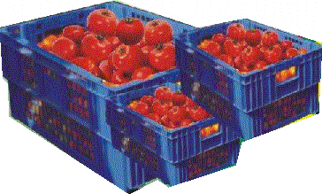
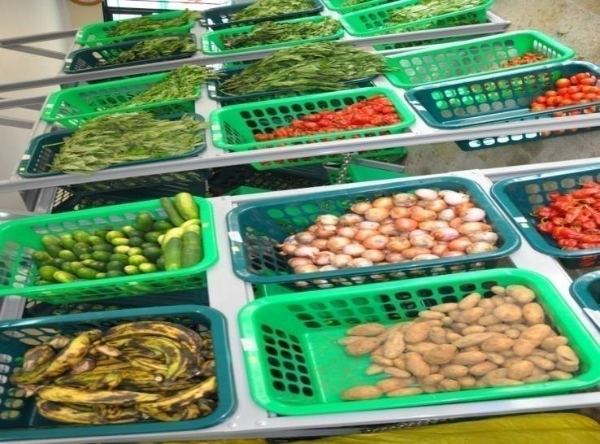
Re - useable Plastic Crates for Fruits and Vegetables

Slide 37
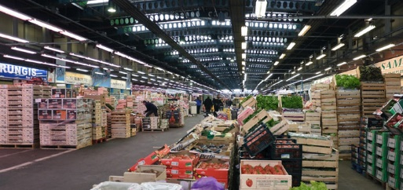
Lagos Market (Future Project)
Wholesale market, where farmers and traders meet to supply aricultural products
Eko City Farmers’
Market

Slide 38
Lagos Market (Future Project)
 | Direct Jobs | Indirect Jobs | Induced jobs | Total
Lagos traders Market | 400 | 642 | 468 | 1510

Slide 39
MoA Impact on Sustainable Employment
 | Direct Jobs | Indirect Jobs | Induced jobs | Total
Farmers (Paddy) | 20 000 | 14 880 | 10 440 | 45 320
Rice Mill Staff | 500 | 5 320 | 2 140 | 7 960
Abattoir | 100 | 255 | 126 | 481
Lagos traders Market | 400 | 642 | 468 | 1 510
 |  |  | Grand Total | 55 271

Slide 40
Social Impact
This is the total in terms of people who will recieve a salary.
There is still the impact on families , we calculate at 5 Family memebers per employee. This will give us the impact on Lagos as a city.
55 271 X 5 member per family = 276 355 Citizens of Lagos are have a better life through intiatives by the Ministy of Agriculture in Lagos

Slide 41
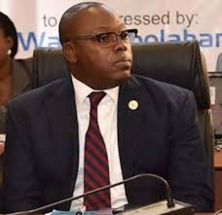
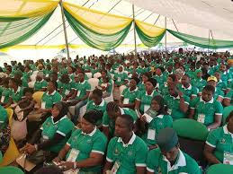

Vocational Skill Programmes
Fighting the menace of unemployment and poverty is the drive behind the previous Lagos State Agricultural Youth Empowerment Scheme (Agric - YES) and the current Lagos Agripreneurship Programme (LAP), which has just been flagged - off by the Lagos State Governor, Mr. Babajide Sanwo-Olu

Slide 42
EMPLOYMENT GENERATION SCHEME IN MINISTRY OF AGRICULTURE
Contact information: lagosagric01@yahoo.com, info@lagosappeal.ng
S/N | Programme | Duration | Frequency | Number of Slots | Number Previously Assisted
1 | Women and Youths Empowerment under the Agro – Processing, Productivity Enhancement and Livelihood Improvement Support Project (APPEALS) | 2 weeks | 4 times per annum | 1,700 | 700 trained
2 | Agricultural Youth Empowerment Scheme (Lagos Agripreneurship Programme) | 4 weeks | 5 times | 2,000 | 200
3 | Agricultural Youth Empowerment Scheme (Agric - YES) | 1 year | Annually | 600 | 300 trained and empowered while another 300 trained and yet to be empowered
4 | Agricultural Value Chain Empowerment Scheme | 4 weeks | Annually | 2,726 | 11,233 across all the Agricultural Value Chains
5 | Coconut Value Chain Development
A | Coconut Bread Empowerment Initiative | 4 weeks | 5 times in a year | 200 | 100
B | Capacity Building along three main coconut products; coconut oil, activated carbon and arts & crafts | 8 weeks | 4 times a year | 500 | 1,200
C | Coconut Production – Out – Growers’ Scheme for Seedling Production | All year round | Annually | 200 | 800

Slide 43
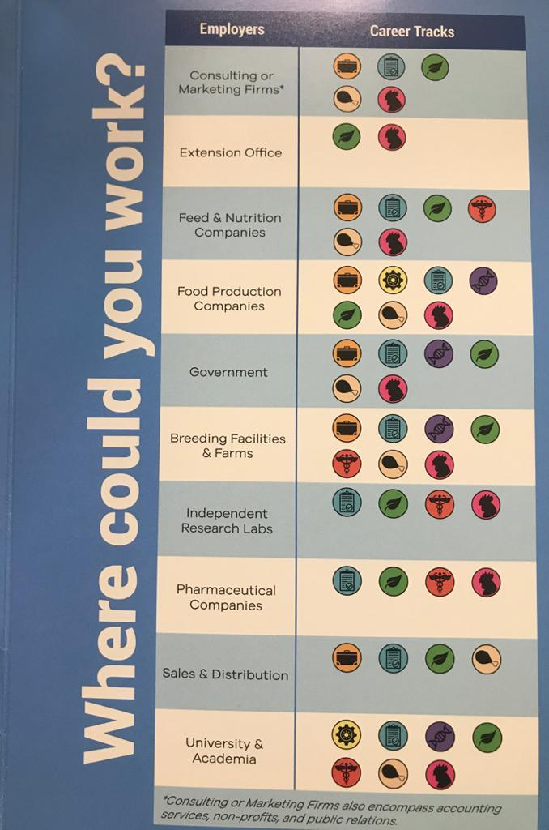

Slide 44
Conclusion:-
The list of opportunities open to an agripreneur in the renewed drive geared towards making agriculture a revenue spinner and an employment generating medium for the youths of Lagos State and the Nation at large, is endless.
It is therefore paramount to encourage the present teeming population of youths to embrace agriculture and explore the various opportunities available therein.

Slide 45


Lagos State Ministry of Agriculture
Making an Impact
Your Taxes at Work
Sustainable Future Growth

